Slide 1

Xamarin Binding / Custom Renderer Xamarin.Android (C#) and Native Android (Java)
Reynaldo Monares
Jr. Mobile App Developer at Tianggee

Slide 2
Binding a Java Library
The third-party library ecosystem for Android is massive. Because of this, it frequently makes sense to use an existing Android library than to create a new one.

Slide 3
Xamarin Binding

Slide 4
Custom Renderer

Slide 5
Custom Renderer
Custom renderers provide a powerful approach for customizing the appearance and behavior of Xamarin.Forms controls.
They can be used for small styling changes or sophisticated platform-specific layout and behavior customization.

Slide 6
Renderer Base Classes and Native Controls
Every Xamarin.Forms control has an accompanying renderer for each platform that creates an instance of a native control.
With the exception of the MapRenderer class, the platform-specific renderers can be found in the following namespaces:
iOS – Xamarin.Forms.Platform.iOS
Android – Xamarin.Forms.Platform.Android
Android (AppCompat) – Xamarin.Forms.Platform.Android.AppCompat
Universal Windows Platform (UWP) – Xamarin.Forms.Platform.UWP

Slide 7
Renderer Base Classes and Native Controls
The MapRenderer class can be found in the following namespaces:
iOS – Xamarin.Forms.Maps.iOS
Android – Xamarin.Forms.Maps.Android
Universal Windows Platform (UWP) – Xamarin.Forms.Maps.UWP

Slide 8
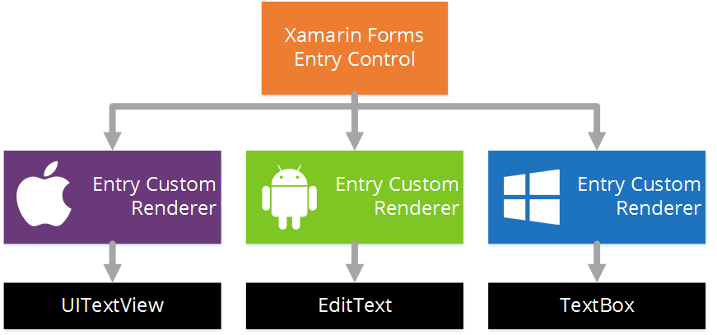
How Entry Control is rendered in each Platform?

Slide 9
How?

Slide 10
The rendering process can be taken advantage of to implement platform-specific customizations by creating a custom renderer for the Entry control in each platform.
Create a Xamarin.Forms Custom Control.
Consume the custom control from the Xamarin.Forms.
Create the custom renderer for the control on each platform.

Slide 11
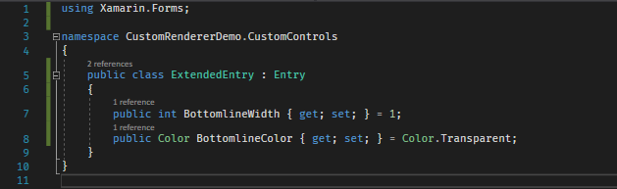
Create a Xamarin.Forms Custom Control

Slide 12
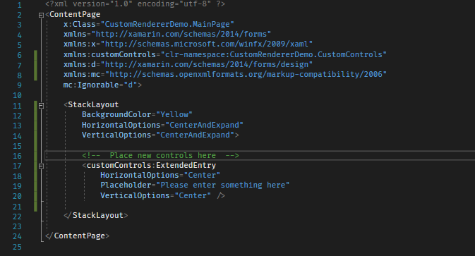
Consume the custom control from the Xamarin.Forms.

Slide 13
Android
Create the custom renderer for the control on each platform.

Slide 14

entrynobottomline.xml

Slide 15
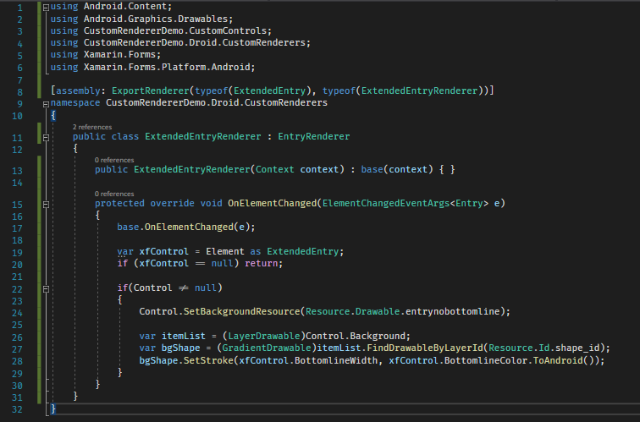
ExtendedEntry.cs

Slide 16
iOS
Create the custom renderer for the control on each platform.

Slide 17
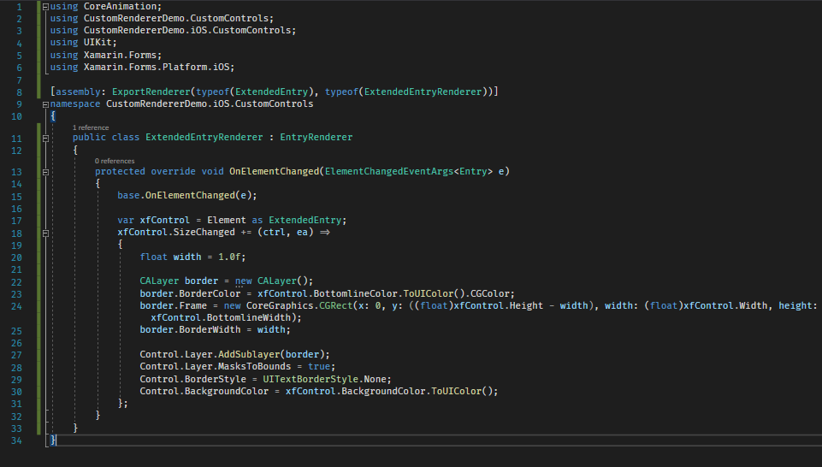
ExtendedEntry.cs

Slide 18
Demo Project at
https://github.com/reynzdev/Xamarin.CustomRenderer.Demo

